Slide 1
Becoming a contemplative educator
Education Insight Series
Applying Contemplative Pedagogy 4
Dr Caroline Barratt
School of Health and Social Care

Slide 2
Outline
Introductions
What is contemplative pedagogy?
What is a contemplative educator?
How will contemplative practice benefit me and my students?
Opportunities for awareness and contemplation

Slide 3

Contemplation
‘the action of looking thoughtfully at something for a long time’
‘deep reflective thought’
https://www.google.com/search?q=contemplation+defintion&rlz=1C1GCEA_enGB765GB765&oq=contemplation+defintion&aqs=chrome..69i57j0l5.2287j1j7&sourceid=chrome&ie=UTF-8

Slide 4
Contemplative pedagogy
“...‘first person’ approaches which connect students to their lived, embodied experience of their own learning. Students are encouraged to become more aware of their internal world and connect their learning to their own values and sense of meaning which in turn enables them to form richer deeper, relationships with their peers, their communities and the world around them”
(Barratt 2014 https://contemplativepedagogynetwork.com/what-is-contemplative-pedagogy/)

Slide 5
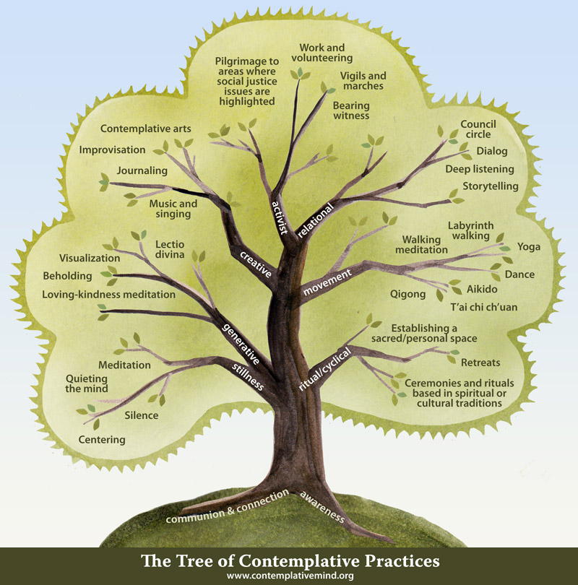

Slide 6
Contemplative educator
“...‘first person’ approaches which connect educators to their lived, embodied experience of their teaching. Educators are encouraged to become more aware of their internal world and connect their teaching to their own values and sense of meaning which in turn enables them to form richer deeper, relationships with their colleagues, students, communities and the world around them”
(Adapted from Barratt 2014 https://contemplativepedagogynetwork.com/what-is-contemplative-pedagogy/)

Slide 7
‘…relishes in the wordless…’
‘Whereas critical consciousness privileges the world of words…[the] contemplative relishes in the wordless, though tangible, dimensions of experience. That is why it defies definition.’
(Mah y Busch 2014: 126)

Slide 8
Contemplative practice
Spatial turning inward
Different engagement with time - from doing to being
An intention to be aware and attend to experience in a different way
(Ergas 2018)

Slide 9


Slide 10


Slide 11
Contemplative educator
Embodiment is key
Not just about using contemplative practices with students
Engaging with our own interiority
Exploring how that meets the world both in terms of how we experience the world as well as how the world experiences us

Slide 12
Breath awareness practice

Slide 13
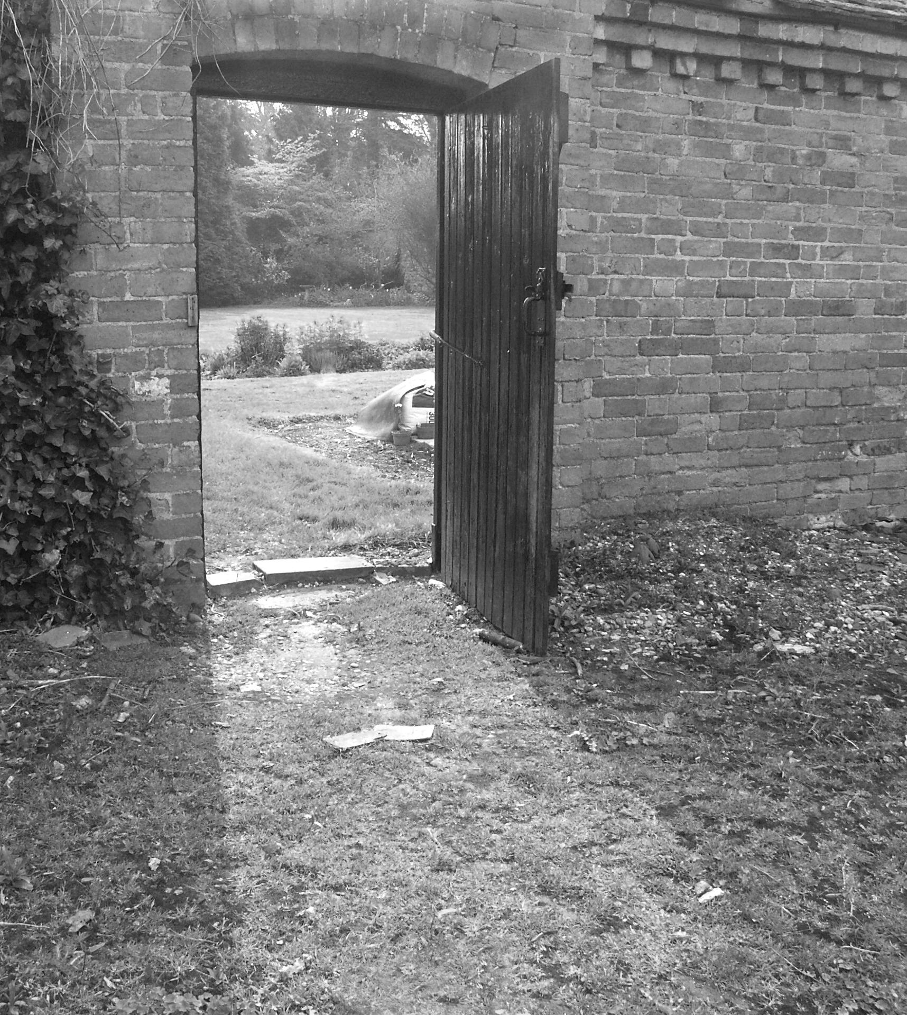
Notes:
“...we not educated in making meaning of this internal life…The more we lean towards attending out there, the more our reality is defined by that which we find out there to which we attribute worthiness and meaning”
(Ergas 2017: 131)

Slide 14
Meaning and transformation
“...we not educated in making meaning of this internal life…The more we lean towards attending out there, the more our reality is defined by that which we find out there to which we attribute worthiness and meaning”
(Ergas 2017: 131)
Notes:
So if meaning making is important in the process of transformation we need to know where meaning is created – where does it come from?
[quote]
Mezirow who developed transformative learning theory also recognised this.
The choices we make, how we act in the world, the hobbies we take up are to a degree determined by where we find meaning and purpose in your lives
(Meaning can be defined as ‘the end, purpose or significance of something’)
If we are only educated to attend to the world outside of us it is in the outside world that we pursue meaning. What society values we therefore value. It makes it difficult then to express values which contradict those already dominant or at least accepted in society.
This is not just relevant to transformative learning but critical pedagogy too – critical pedagogy is useful and highly values the process of reflection in order to question our place in the world and to become critical of dominant modes of being.
What contemplative pedagogy can bring to this is the valuing of interiority – a reorientation towards our inner experience – a rebalancing of what it is that informs our actions in the world.

Slide 15
Contemplative reflection
Notes:
What meaning does your work hold for you?
What meaning would you like your work to have for your students?
What meaning would like your work have for the world?
Contemplative for 12 minutes followed by 5 minutes silent writing. Group drawing. Then what gets the way….
‘the end, purpose or significance of something’
Drawing - what gets in the way (in discussion?)

Slide 16
Contemplation: transformation not naval-gazing
Become aware of habits and taken for granted
Deepening understanding of and valuing our inner lives
Development of awareness allows greater intentionality and therefore change
May reduce stress and makes space for ‘not knowing’
Values stillness and silence as well as dialogue and connection
Self-care can boost resilience and increase our ability to critically engage with the world.
Notes:
Contemplative pedagogy can prevent, in Ergas’s words, social habits becoming the habits of our own mind.
We can become more deeply critical and more open to transformation as through contemplative practice we develop a clearer sense of reality – we come to see that it is our minds which are attributing meaning and that we have agency over that.
Otherwise we habitually take on the meaning attributed by society and our capacity to then be critical and to be open to deep transformation are limited – we become fixed because we consider our internal lives to be dictated by what is external to us, we do not see the agency that we have, the authority that we give away.
That is not to say that our lives are not conditioned by the circumstances around us, the contemplative pedagogy project is one of rebalancing not domination.
So by introducing a contemplative element in to teaching, by valuing interiority, its role in meaning making, and the fresh perspective this might offer on our habits of mind, we increase the possibility of transformative learning.

Slide 17


Slide 18
Becoming a contemplative educator
In the classroom
Becoming more present – being conscious of the transition into teaching, stepping into that role, bring your intentions to mind
Creating spaciousness – allowing silence, not packing with content, encourage exploration
Remaining mindful as you teach - your body, speech, mind
Be as ready to learn as you are to teach

Slide 19
Teaching from ‘now’
As you reach the door into the lecture theatre/classroom take a deliberate breath.
Feel the air enter and then leave your body.
Notice the sensations the door handle in your hand.
Notice the movements of you body as you enter the room.
Mindfully move your gaze slowly across the room, take in what you see.
Recognise that these students (and those coming in late!) will be your teachers today. Have a sense of open heartedness and gratitude to them.
As you prepare to teach, setting up IT etc be mindful of how you are feeling any tension or anxiety. Recognise this. Breathe.
When you are ready to start walk out to the front of the classroom, with a full body awareness, greet your class and start…

Slide 20
Becoming a contemplative educator
Outside the classroom
Develop your own contemplative practice (possibilities are endless!)
Explore your motivation and intentions – where do you find meaning in your work? How can you bring this more into what you do?
Start to notice how you are influenced by colleagues/institution/society explore how to challenge what does not fit with your values/intention (in others & in ourselves).
Connect with others and build community

Slide 21
“Face to face with my students, only one resource is at my immediate command: my identity, my selfhood, my sense of this “I” who teaches—without which I have no sense of the “Thou” who learns…
In every class I teach, my ability to connect with my students, and to connect them with the subject, depends less on the methods I use than on the degree to which I know and trust my selfhood—and am willing to make it available and vulnerable in the service of learning.”
(Palmer n.d.:2)

Slide 22
‘We can choose the way we teach’
Palmer and Zajonc (2010: 89)
Notes:
To be great, be entire:
Of what is yours nothing exaggerate or exclude
Be whole in each thing.
Put all that you are
Into the least you do
Like that on each place the whole moon
Shines for she lives aloft.
By F Pessoa

Slide 23
References and resources
Ergas, O. 2017. Reconstructing 'Education' through Mindful Attention - Positioning the Mind at the Center of Curriculum and Pedagogy. London: Palgrave Macmillan
Mah y Busch, J. 2014. A Pedagogical Heartbeat: The Integration of Critical and Contemplative Pedagogies for Transformative Education. The Journal of Contemplative Inquiry 1 (1): 121-142.
Palmer, P. J., and A. Zajonc. 2010. The Heart of Higher Education: A Call to Renewal. San Francisco: John Wiley & Sons
Palmer, P. n.d. Heart of a teacher: identity and integrity in teaching
http://www.couragerenewal.org/parker/writings/heart-of-a-teacher/
Books and papers
Barbezat, D. P., and M. Bush. 2014. Contemplative Practices in Higher Education: Powerful Methods to Transform Teaching and Learning. San Francisco: John Wiley & Sons.
Zajonc, A. 2009. Meditation As Contemplative Inquiry: When Knowing Becomes Love. Massachusetts: Lindisfarne Books.
Websites and institutions
Association for Contemplative Mind in Higher Education http://www.contemplativemind.org/programs/acmhe
Contemplative Pedagogy Network https://contemplativepedagogynetwork.wordpress.com/
Videos
Barbezat, D. 2014. Contemplative Pedagogy. http://www.youtube.com/watch?v=Y5iARQfWRZQ&feature=youtube_gdata_player..
Zajonc, A. 2013. The Heart of Education (http://vimeo.com/62676465). Keynote speech at the Mindfulness In Education conference. Cambridge, MA.

